Slide 1




NEXT GEN EMPLOYABILITY PROGRAM
Creating a future-ready workforce
Team Members
College Name
Student Name : Mohamed riyas deen.m
Student ID :au951221104024
JP College Of Engineering

Slide 2

CAPSTONE PROJECT SHOWCASE
Project Title
Voting Web Application using Django Framework
Abstract | Problem Statement | Project Overview | Proposed Solution | Technology Used | Modelling & Results | Conclusion

Slide 3
Abstract
Built on Django, our voting web application streamlines democratic engagement. Users effortlessly register, peruse polls, and securely submit their votes. Django's sturdy framework guarantees scalability and preserves data integrity, safeguarding user privacy. With an intuitive UI/UX design, navigating the platform is seamless, elevating the user experience. Real-time updates and transparent result displays cultivate trust in the electoral process, fostering confidence in digital democracy. Empowering civic involvement, our application revolutionizes the landscape of digital democracy.
Source :

Slide 4
Problem Statement
Existing voting systems suffer from limited accessibility and user-friendliness, discouraging participation. Persistent doubts surrounding the integrity and security of online voting platforms persist. The lack of real-time updates and transparency erodes confidence in electoral outcomes. The constrained scalability and adaptability of current solutions impede widespread adoption and efficacy..
Source :

Slide 5
Project Overview
The project's objective is to create a secure and user-friendly online voting and survey platform, utilizing the Django framework.
Key functionalities include user authentication, user-friendly interfaces for both administrators and participants, real-time result updates, and data visualization.
The project harnesses Django's robust backend features, coupled with HTML/CSS/JavaScript for frontend design, and potentially incorporates additional libraries or frameworks for extended functionality.
Upon completion, the project will provide a scalable and dependable voting solution, emphasizing security, ease of use, and inclusivity, adaptable for diverse applications like elections, opinion polls, or feedback collection.
Source :

Slide 6
Proposed Solution
.
Create a user-focused voting web application utilizing Django framework for reliability and scalability. Implement encryption and secure authentication protocols to safeguard the integrity and confidentiality of voter data. Integrate real.
Source :

Slide 7
Advantages
Enhanced Engagement: Accessibility across all internet-connected devices promotes wider participation in the voting process. Streamlined Development: Utilizing the Django framework accelerates development cycles, maximizing resource efficiency. Heightened Security: Implementation of encryption and authentication protocols fortifies the safeguarding of voter data, minimizing the potential for tampering or unauthorized access. Transparent Governance: Real-time result tracking and transparent reporting foster confidence in electoral procedures, strengthening trust in democratic principles..
Source :

Slide 8
Disadvantages
Risk of Technical Issues: The intricacies of web app development may result in glitches or system malfunctions, potentially disrupting voting procedures and undermining user confidence. Exposure to Cyber Threats: Despite security measures, online platforms are vulnerable to cyberattacks, posing risks to the integrity and privacy of voter data. Digital Divide: Reliance on internet access excludes individuals lacking reliable connectivity or tech proficiency, exacerbating disparities in democratic engagement. Regulatory Complexity: Adhering to various legal frameworks and electoral regulations presents logistical challenges and could hinder the deployment of the voting web application.
Source :

Slide 9
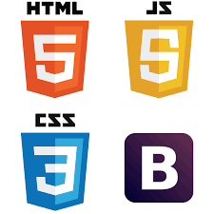


Technology Used
Frontend
Backend
Source :

Slide 10
Modelling & Results
Data Structuring: Utilize Django's ORM to organize data effectively, enhancing storage and retrieval of user, poll, and voting information. Algorithm Development: Create algorithms for vote processing and result computation, guaranteeing precision and responsiveness in presenting real-time outcomes. Verification and Testing: Perform comprehensive testing to validate model functionality and algorithmic accuracy, resolving any inconsistencies or issues to preserve data integrity. .
Source :

Slide 11
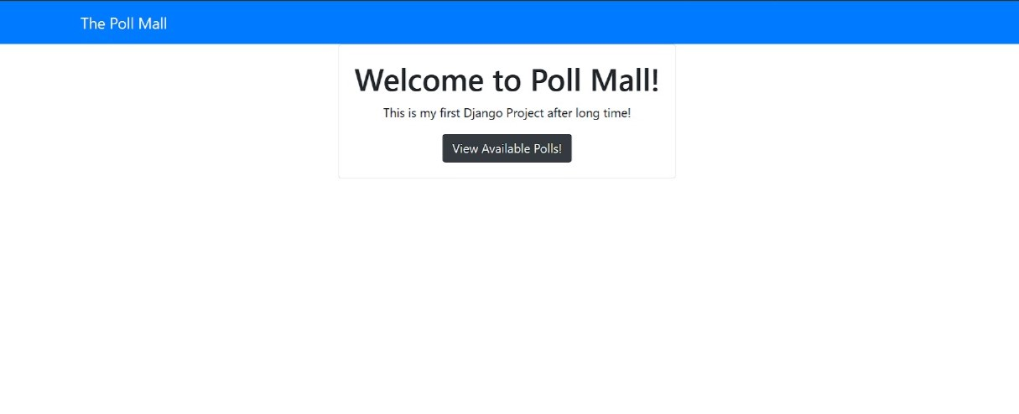
Homepage

Slide 12
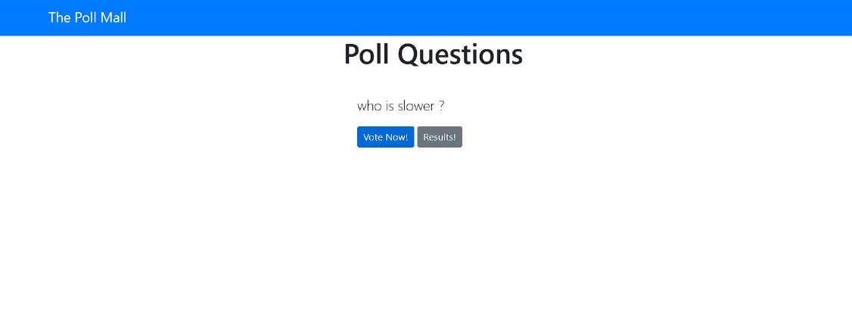
Polling questions page

Slide 13
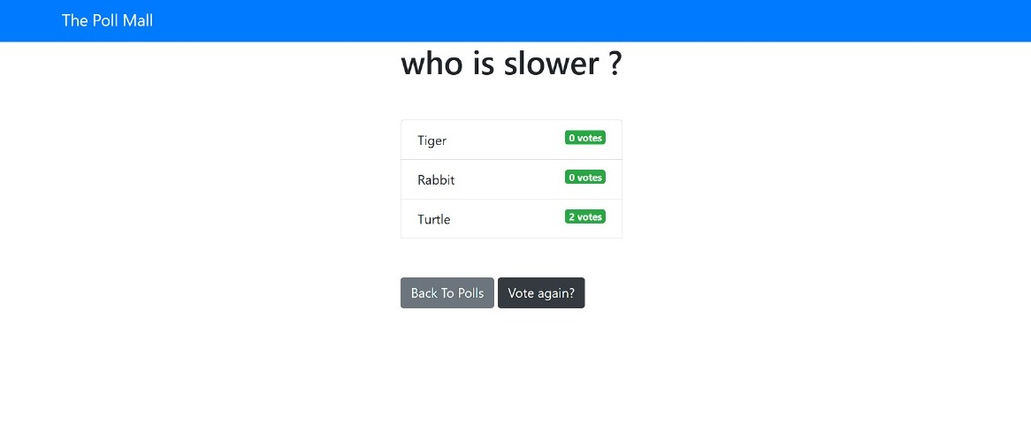
Voting page

Slide 14
Future Enhancements:
Blockchain Integration: Investigate the integration of blockchain technology to bolster security and transparency in the voting process.
AI-Driven Customization: Deploy AI algorithms to personalize user interactions, delivering tailored recommendations and alerts.
Mobile App Creation: Enhance accessibility through the development of specialized mobile apps, enabling smooth voting experiences on handheld devices.
Gamification Integration: Incorporate gamification elements to incentivize participation and encourage community involvement within the voting platform.

Slide 15
Conclusion
In summary, the development of a voting web application utilizing the Django framework holds immense potential for modernizing electoral processes. With a focus on accessibility, security, and transparency, our goal is to empower citizens to actively engage in democratic decision-making. Despite challenges such as technical intricacies and regulatory compliance, the anticipated benefits of heightened participation and increased trust in governance are substantial. Continuous refinement through rigorous testing, vigilant monitoring, and iterative enhancements will be pivotal in ensuring the efficacy and dependability of the platform. Ultimately, by embracing innovation and leveraging technology ethically, we can advance the fundamental principles of inclusivity, accountability, and civic empowerment in the digital era.
Source :

Slide 16
Thank You!
Notes:
Thank You !!

